Slide 1



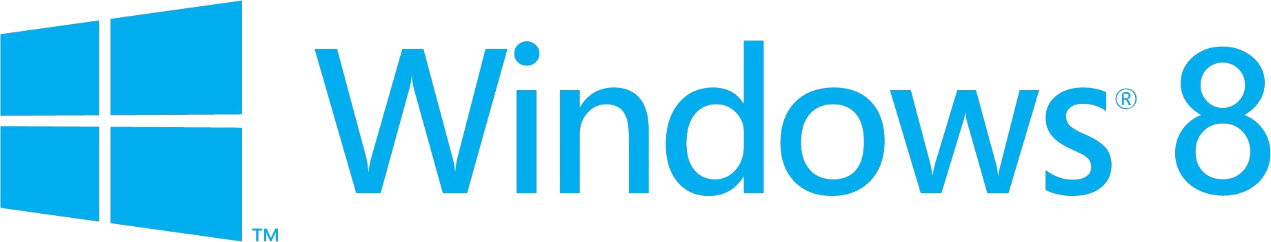
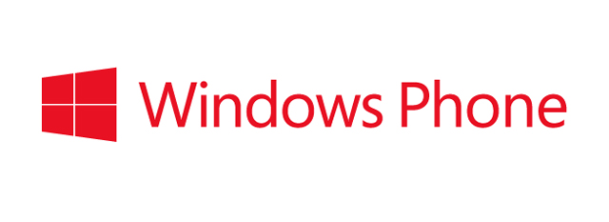
Windows Phone 8 Store & Monetization

Slide 2
Windows Phone Store & Monetization
Store and Monetization
Monetization Strategies
Ads in Windows Phone
Submitting to the Store

Slide 3
Monetizing Your App
Sell
Advertisements
In-App Purchases

Slide 4
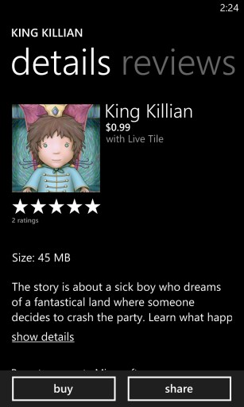
Sell your Application
Regular Sale
70% of app price goes to the developer
Payments start at $200, made by bank transfer

Slide 5
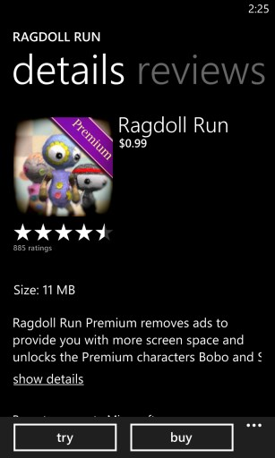
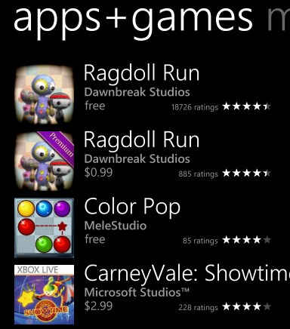
Sell your Application
Try Before You Buy
Determine in-app which version is running
Trial apps do not show up under “free” searches
Consider light-premium pricing model

Slide 6
Detecting Trial Mode
using Microsoft.Phone.Marketplace;
LicenseInformation info = new LicenseInformation(); if ( info.IsTrial() ) { // running in trial mode }

Slide 7
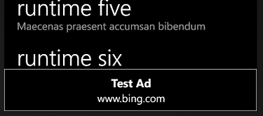
Advertisements
Microsoft Advertising SDK
Takes user to website
Developers get 70% of ad revenue

Slide 8
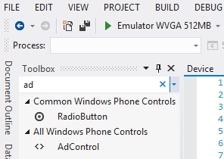
Adding Ads to an Application
The Advertising SDK is distributed as part of the Windows 8 SDK

Slide 9
Adding Ads to an Application
AdControl adControl = new AdControl("test_client", // ApplicationID
"Image480_80", // AdUnitID
true); // isAutoRefreshEnabled

Slide 10
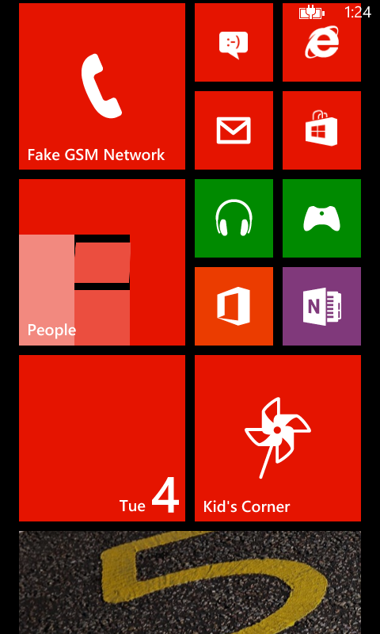
Windows Phone 8 Trial API and Ads Demo

Slide 11
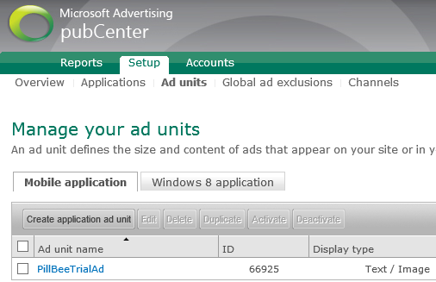
Adding Advertisements to Applications

Slide 12
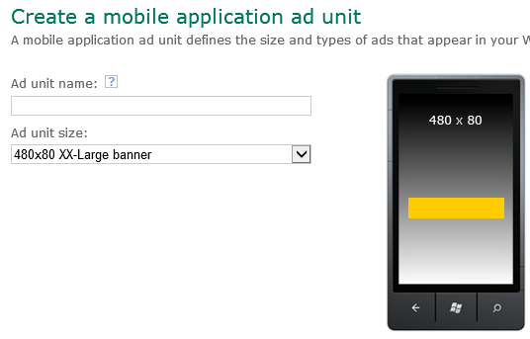
Adding Advertisements to Applications

Slide 13
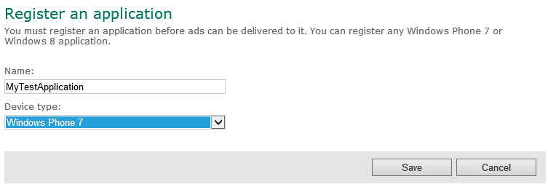
Adding Advertisements to Applications

Slide 14
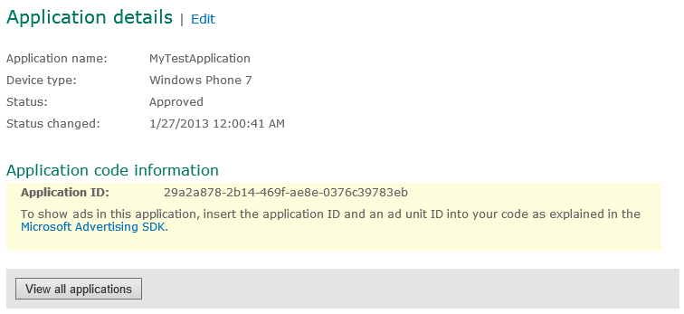
Adding Advertisements to Applications

Slide 15
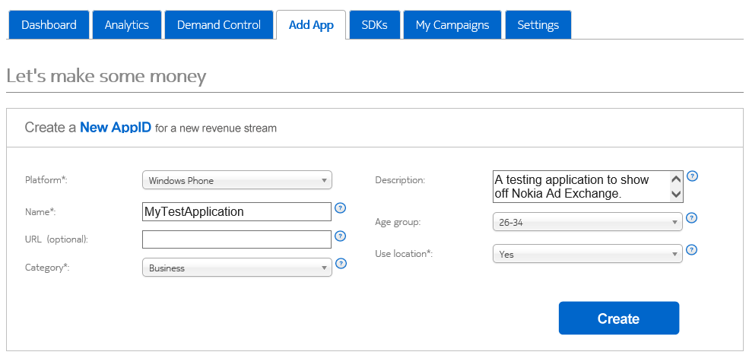
Other Advertising Options
Nokia Advertising Network
http://nax.nokia.com/iamp/nokia/signup

Slide 16
In-Application Sales
Windows Phone 8 allows you to sell upgrades and additional features to users from within your app
The Windows Store can issue signed receipts for purchases which can be used to authenticate access to resources

Slide 17
In-App Purchase
8.0
Recurring Revenue Opportunities
Extend reach
Attract a larger user base with free baseline experience
Upsell
Upsell users to purchase paid digital goods and services that enhance or extend the app experience in the app itself
Customize
Add and modify different paid options for different user segments

Slide 18
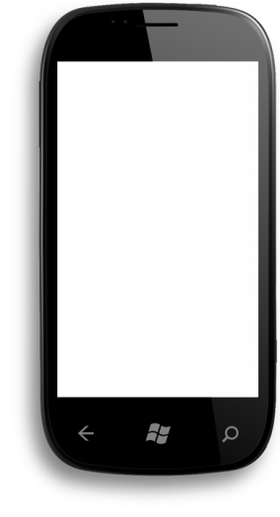
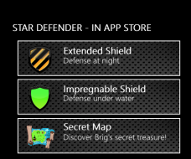


In-App Purchase used for digital content
8.0
Offer digital assets
Durables
buy once & own forever, e.g. new game levels, maps, game items
Consumables
game currency, movie rentals, access to digital magazines for 6 months, etc.
Hand’s On
A test of dexterity
Coffee Cup
Custom hot beverages
Global Reach
A strategy exercise
Notes:
The items that you sell can be split into two categories
Durable
Items that, once purchased, remain the property of the user of the application
Activation of features in a program
Consumable
Items that are consumed by the user of the application
Points for use in a game
Access time for a paid resource or service

Slide 19
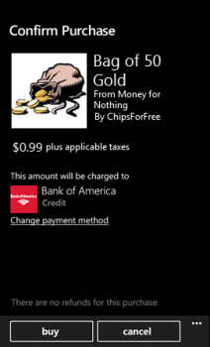
In-App Purchase: sell items in your app
8.0
Define In-App Item
Use App Hub to define Consumable (bullets) or durable (guns)
Integrate In-App to app experience
Use SDK to sell items
Large Bag of Coins
Use the golden coins to buy food and clothing for your game pet, and help it grow faster!.
Price $1.99
Choose Countries and Pricing
Use App Hub to define item price; change as frequently as needed
Manage, monitor and respond
Use App hub to manage sales reports, by item, region, date
Notes:
You provide
products that can be sold in your app
clear and accurate product information
the ability to initiate a purchase from within your app, that is, a “buy button”
product delivery and/or enablement, also known as fulfillment
Microsoft provides
product management tools through the Windows Phone Dev Center
geo-distributed services
a purchase user experience that is consistent across all apps on the phone
the ability to pay you in 190 countries or regions
proof of purchase authenticity through secure receipts

Slide 20
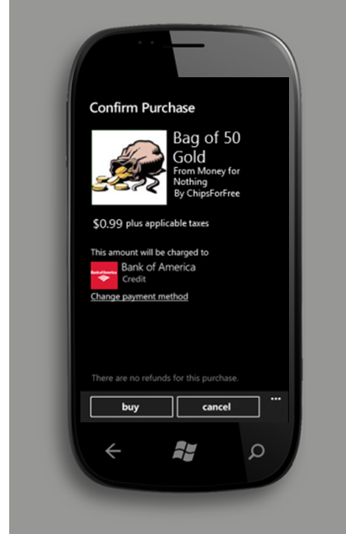
Making an in-application purchase
await CurrentApp.RequestProductPurchaseAsync(“Bag of Gold", false);
This statement purchases the “Bag od Gold” product
The second parameter (in this case false) determines if a receipt is to be provided for the purchase
Notes:
The RequestProductPurchaseAsync causes the purchase UI to be displayed and the purchase made.

Slide 21
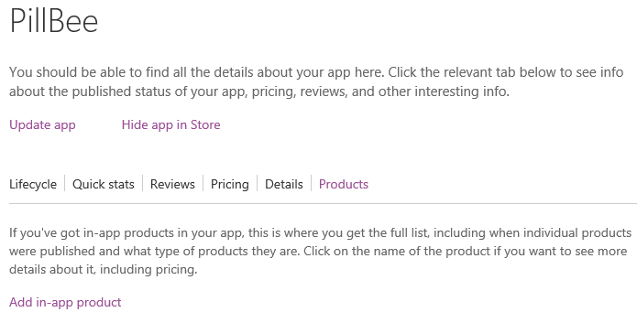
Putting Products into the Microsoft Store
http://aka.ms/InAppPurchase

Slide 22
Verifying licence purchased
var productLicenses = CurrentApp.LicenseInformation.ProductLicenses;
var licence = productLicenses["Special Cheese"];
if (licence.IsActive)
{
// enable Special Cheese Power
CurrentApp.ReportProductFulfillment("Special Cheese");
}
If the product is a consumable it can be purchased again
The application must securely store the new status setting
Notes:
Licensing is a critical part of In-App Purchase. It tells your app what products the user has a license to use. These products can be consumables or durables. There are specific conditions under which license information should be verified to ensure that the user gets the experience, and in-app products, to which they are entitled. Any mistakes or errors in this process may frustrate the user and lead to lower sales, bad reviews and a bad reputation.
The CurrentApp.LicenseInformation API has been optimized for memory, performance and security characteristics and to be callable on boot, activate and resume. Because license state can change without the app receiving a notification (by purchases from other phones or by user activity at the Windows Phone Store), you should rely on this API as the primary source of truth about what the user currently owns rather than storing the returned licenses in your own local storage.

Slide 23
Managing the state of a consumable
var productLicenses = CurrentApp.LicenseInformation.ProductLicenses;
var licence = productLicenses[“Bag of 50 Gold"];
if (licence.IsConsumable && licence.IsActive)
{
// add the extra points
cheesePower = cheesePower + 200; CurrentApp.ReportProductFulfillment("Cheese Power Points ");
}
A consumable item can be purchased multiple times
Notes:
Protect your consumables. The LicenseInformation APIs provide information about purchases, not the state of consumables. For example, if a user purchases a bag of 100 gold in your app, it is your responsibility to track the consumption of that product in a secure way so that the user always sees the correct state of that product (i.e. number of gold remaining). Malicious users may attempt to exploit your storage, artificially increasing the count of owned consumables. Proper security mechanisms should be employed to secure this data.

Slide 24

In-App Purchase Example
Dredd vs. Zombies

Slide 25

10 Tips to Make More Money (1/2)
7.5 & 8.0
1. Use Trial API
70x More Downloads, 7x More Revenue
2. Use Live Tile
Top 50 apps are 3.7x more likely to have
3. Use Push Notifications
Top 50 apps are 3.2x more likely to have
4. Use Ad Control w/ Loc
More local relevance drives higher eCPM
5. Adopt WP Style
Conformant apps are featured more frequently

Slide 26
10 Tips to Make More Money Today (2/2)
7.5 & 8.0
6. Publish Globally
Fastest growth occurring in new markets
7. Localize Smartly
Language, currency, symbols
8. Right Size your App
Apps <90 MB work well on all devices
9. Act on Feedback
Prompt for reviews and feedback . . and fix
10. Update Frequently
Top 50 apps are updated every 2-3 mo.
bugs, fast app switching, engaging user experience

Slide 27
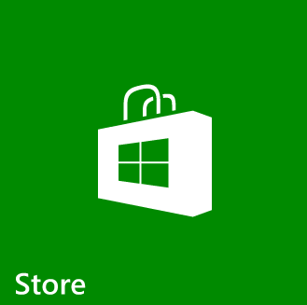
Submission and Validation

Slide 28
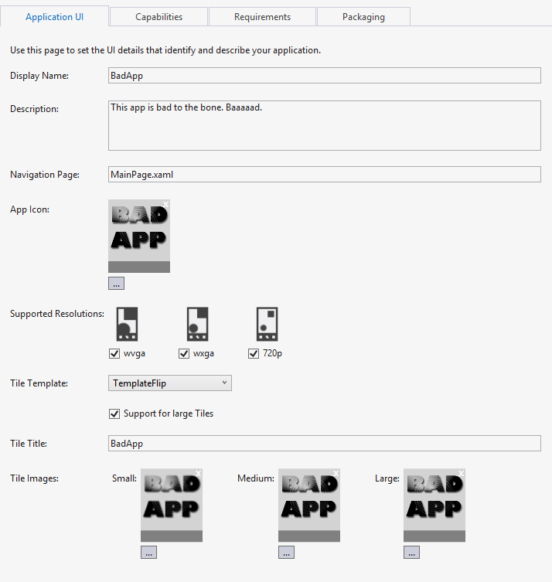
Editing WMAppManifest.xml
Visual Studio provides an editor which an be used to configure the WMAppManifest.xml file
This removes the need to edit the XML directly for most actions
However you may need to make manual changes to configure some application options

Slide 29
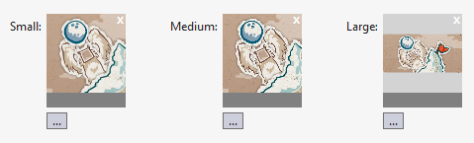
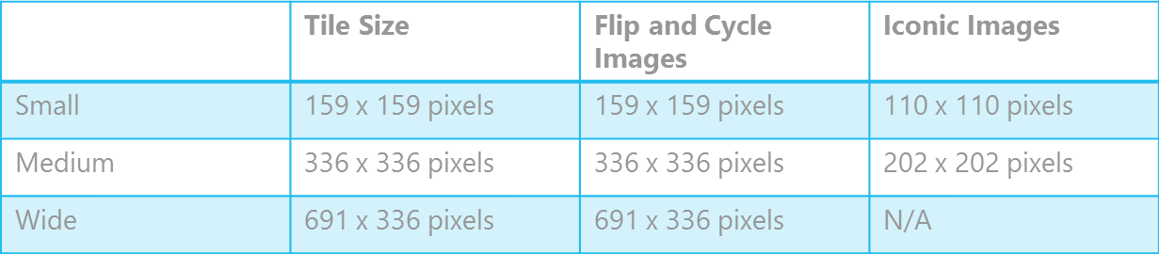
Tile Sizes
You need to provide artwork in the required sizes
You can browse for the artwork from within the manifest file editor

Slide 30
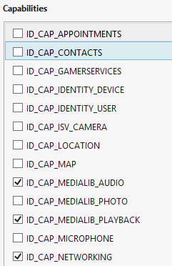
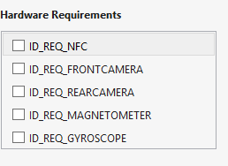
Application Requirements & Capabilities
Requirements
prevent app from being deployed on devices that cannot support it
Capabilities
If you do not enable a required capability the program will throw an exception when it tries to use that particular resource

Slide 31
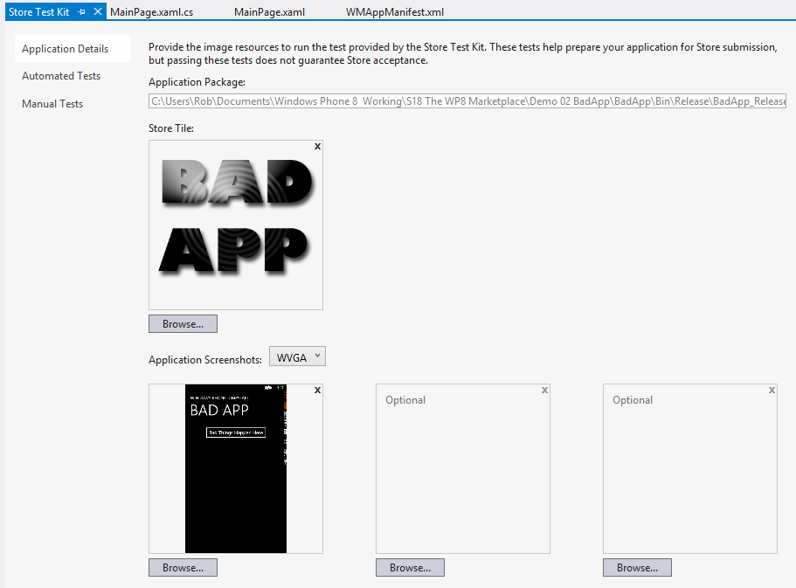
Store Test Interface
The Store Test Kit is located on the Project menu for the solution
Automated and Manual Tests
Add application screenshots

Slide 32
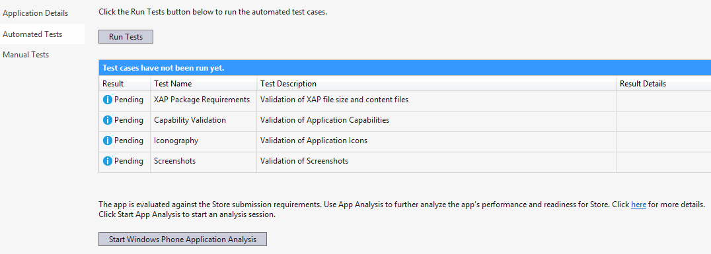
Store Test Kit Application Analysis
Application Analysis performs tests on the application to ensure conformity with Store policies

Slide 33
The Windows Phone XAP file
The XAP file brings together all the elements of your program application
It is the item that is actually pushed onto the device when it is deployed
The XAP file provides a common format for all Windows Phone apps & games
Declarative, manifest-based installation
Integrated into security model of phone
Tied to your developer identity
Signed by an Enterprise for enterprise deployment
Notes:
Make the point that whenever a program is downloaded into a device for execution or deployment it is a XAP file that is sent.
The XAP file is the totality of output from the Visual Studio solution.
It contains XNA content too, if this has been added.

Slide 34
Application Validation
When you submit your application for validation the system performs a number of automated tests
Then the application is manually tested to ensure proper behaviour in a number of scenarios (dormant/tombstone/back button)
The testing process takes a few days and generates a testing report that you can use to fix the problems
This will include specific feedback on the issues that were identified
When the application is resubmitted the retest will focus only on those parts of the application that have changed
Notes:
Make the point that this happens to ensure a certain level of quality of applications.
Remind folks that they can use this service as many times as they like.
My experience has been that the validation process is speedy and the feedback is excellent

Slide 35
Windows Phone 8 Store and Monetization

